Slide 1
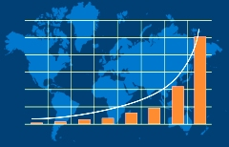
Measuring Development: Key Factors
Insights from Kmeans Cluster
By Hanif K

Slide 2
Analysing the Dataset
The data was measured 167 countries across a number of different developmental factors:
Child mortality
Exports
Expenditure on Healthcare
Imports
Income
Inflation
Life expectancy
Total Fertility
GDP

Slide 3
Goal
Analyse the data and find general correlations and see if they match what we know from development Economics theory.
Key Areas I focused on were:
GDP
Child Mortality
Life Expectancy

Slide 4
Number of Countries and breakdown
Number of countries: 167
Cluster: 3
1st world
2nd world
3rd world

Slide 5
Why GDP?
Yardstick to measure growth. Concrete number

Slide 6
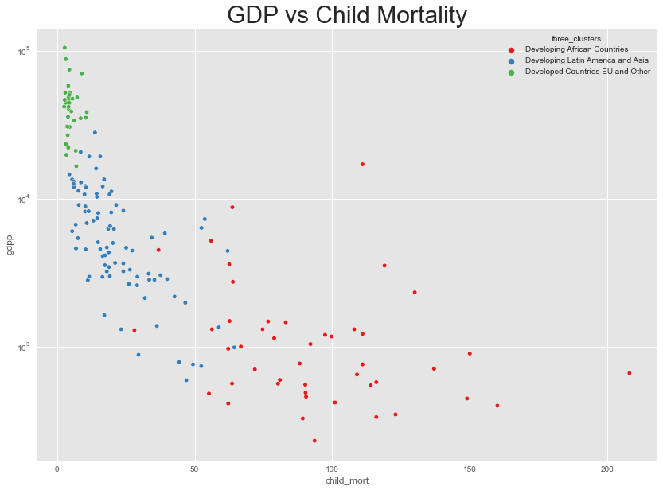

Slide 7
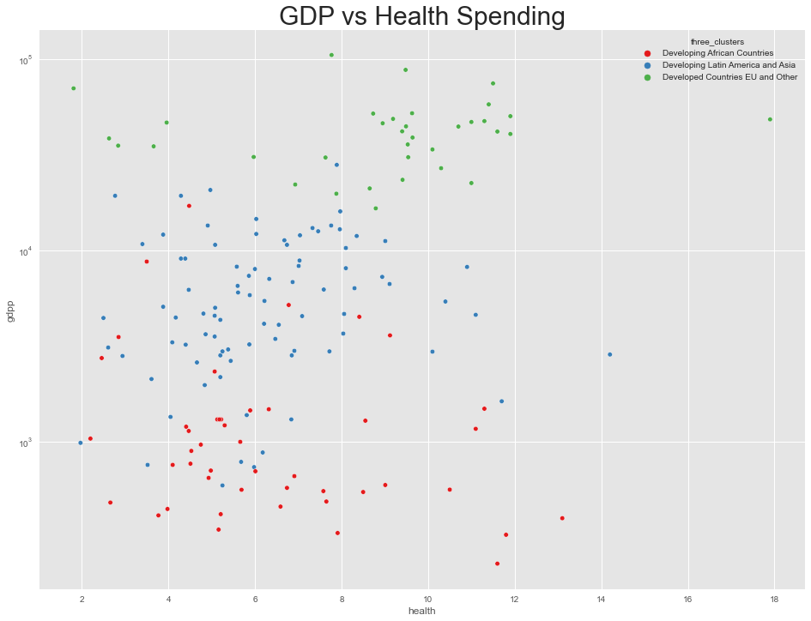

Slide 8
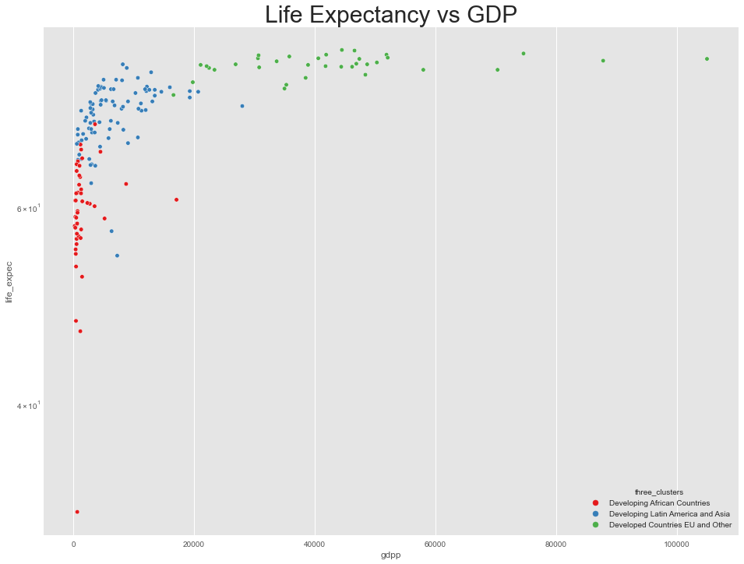

Slide 9
Preston curve
Individuals born in wealthier countries do live longer but its not due to the growth in income, but the reduction in poverty.
Source: Euromonitor International

Slide 10
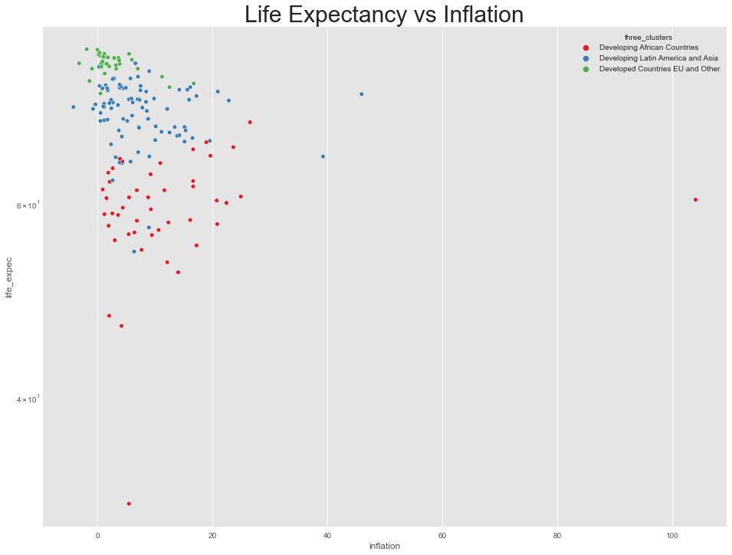
For each unit of increase in the inflation rate a decrease of 20% in life expectancy.
Ref:
International Journal of advanced applied science
Name:
Predictive capacity of country inflation rate to life expectancy at birth
AU - Garcia, Laurence

Slide 11
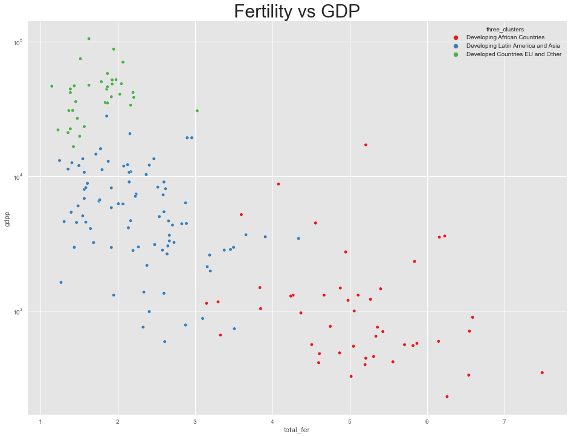
Development is the best contraceptive

Slide 12
Observations
Negative correlation between GDP and Child mortality. The higher the GDP the lower the child mortality rates
Higher the inflation the lower the life expectancy.
There is a correlation between GDP and fertility rates. More development = Fewer Children.

Slide 13
Thank you!

